Slide 1

Unit II Process and Thread Management
Presented By
Dr. Khursheed Ahmad Bhat
Assistant Professor
School of Computer Science
UPES

Slide 2
Lecture Outline
Process Concept
Process States
PCB

Slide 3
Process Concept
An operating system executes a variety of programs that run as a process.
Process – a program in execution;
Program is passive entity stored on disk; process is active
Program becomes process when an executable file is loaded into memory
Execution of program started via GUI mouse clicks, command line entry of its name, etc.
Processes can be CPU-bound or I/O bound in nature.
Execution vs I/O

Slide 4
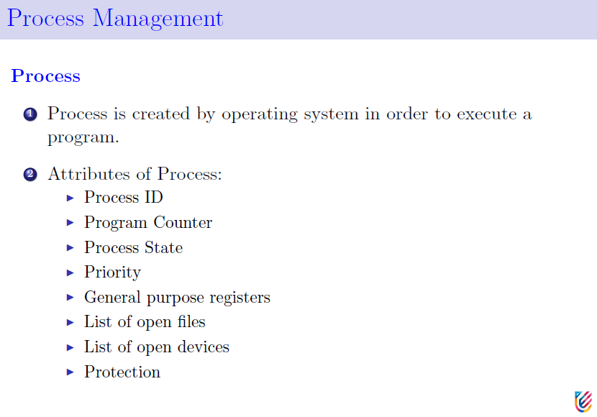
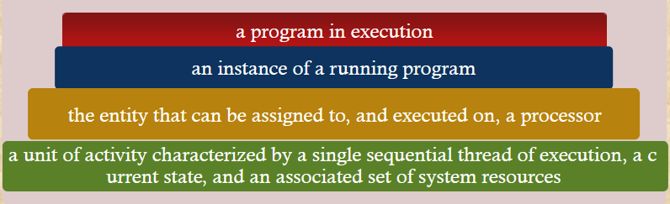

Slide 5
Process State
As a process executes, it changes state
New: The process is being created
Running: Instructions are being executed
Waiting: The process is waiting for some event to occur
Ready: The process is waiting to be assigned to a processor
Terminated: The process has finished execution

Slide 6
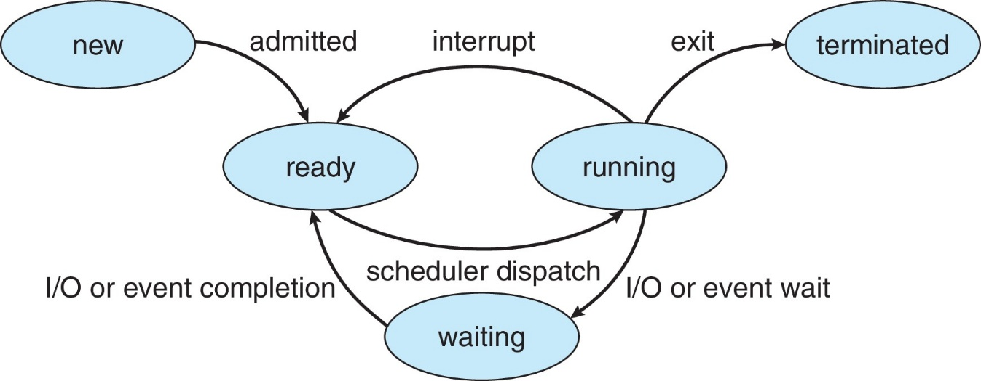
Diagram of Process State

Slide 7
Case Study: Process Management in Linux

Slide 8
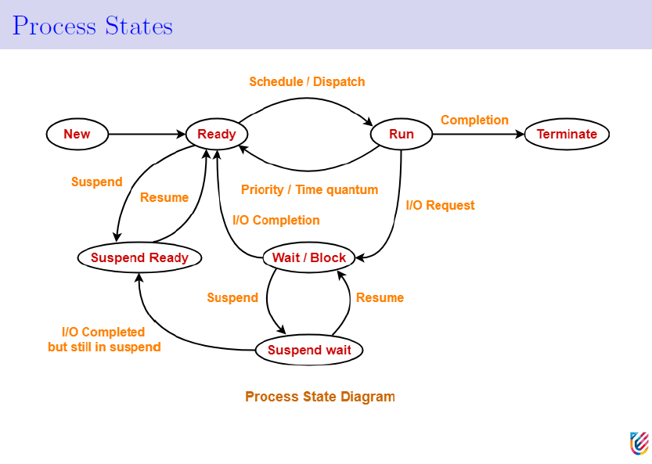
Long-Term Scheduler: New → Ready (controls admission from job pool).
Short-Term Scheduler: Ready → Running (decides CPU execution).
Medium-Term Scheduler: Moves processes to/from Suspended states.

Slide 9
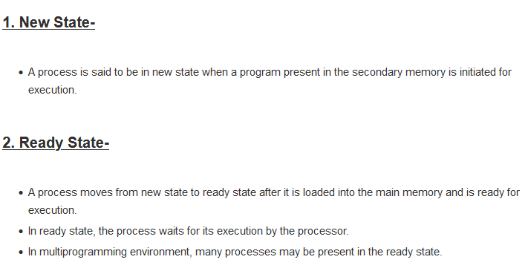

Slide 10
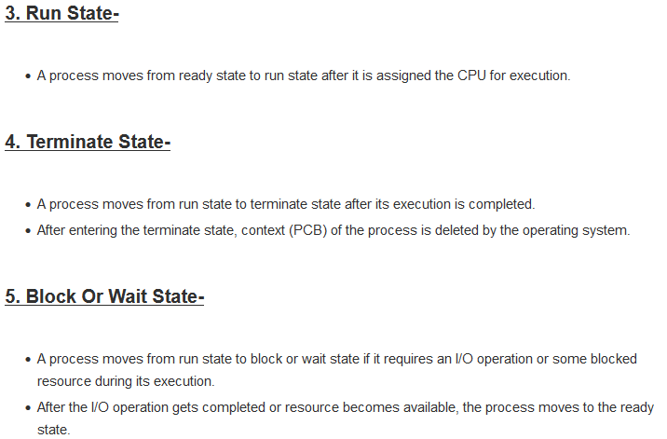

Slide 11
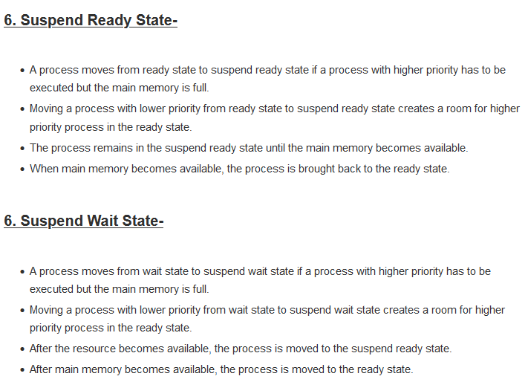

Slide 12
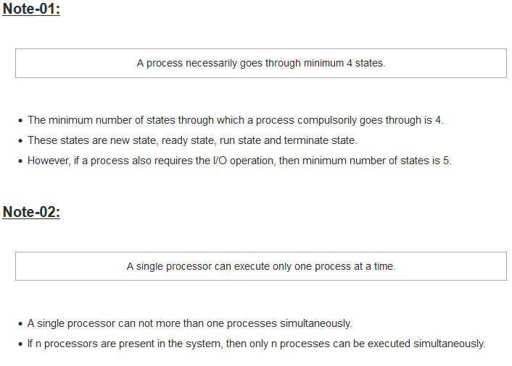

Slide 13
Operations on Process
Creation
System initialization
Execution of a process creation system call by a running process
A user request to create a new process
Initiation of a batch job
Scheduling
Long term scheduling (Degree of Multiprogramming)
Short term scheduling (Dispatcher)
Medium term scheduling (Moves processes to/from Suspended states).
Note: Number of processes that are present in the ready queue at maximum is called Degree of Multiprogramming.

Slide 14
Operations on Process
3. Execution
Once a process is given to CPU, it will start executing
Arrival time, Burst time, Waiting time, Response time
Termination
Normal exit (voluntary)
Error exit (voluntary)
Fatal error (Involuntary)
Killed by another process (Involuntary)

Slide 15
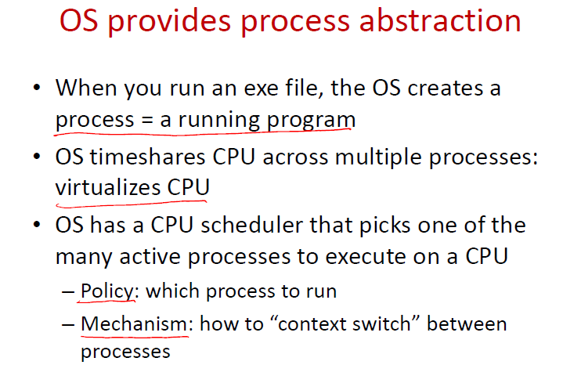

Slide 16
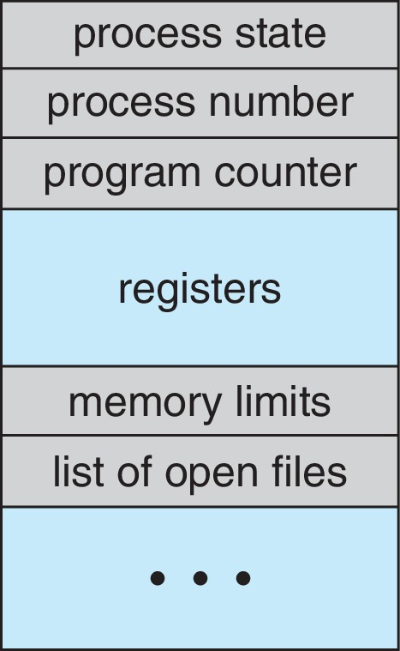
Process Control Block (PCB)
Information associated with each process(also called task control block)
Process id
Process state – running, waiting, etc.
Program counter – location of instruction to next execute
CPU registers – contents of all process-centric registers
CPU scheduling information- priorities, scheduling queue pointers
Memory-management information – memory allocated to the process
Accounting information – CPU used, clock time elapsed since start, time limits
I/O status information – I/O devices allocated to process, list of open files

Slide 17
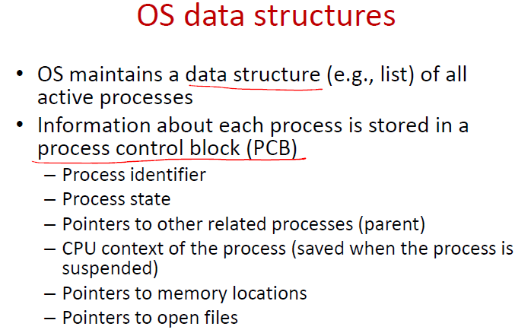

Slide 18
Data Structure
A data structure is a way of organizing and storing data in a computer so that it can be used efficiently.
A data structure is a specialized format for organizing, storing, and managing data in a computer so that it can be accessed, modified, and processed efficiently.
Integers, floats, characters, pointers, etc
Arrays, Linked Lists, Stacks, Queues
Trees, Graphs

Slide 19
Process Control Block
Process Control Block (PCB) is a data structure that stores information about a particular process.
This information is required by the CPU while executing the process.
Each process is identified by its own process control block (PCB).
It is also called as context of the process.

Slide 20
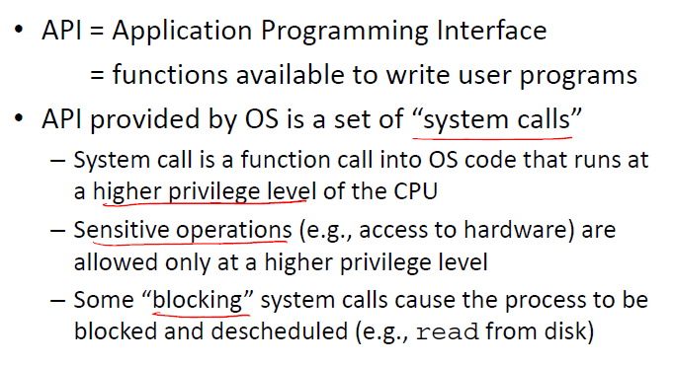
Operating System API

Slide 21
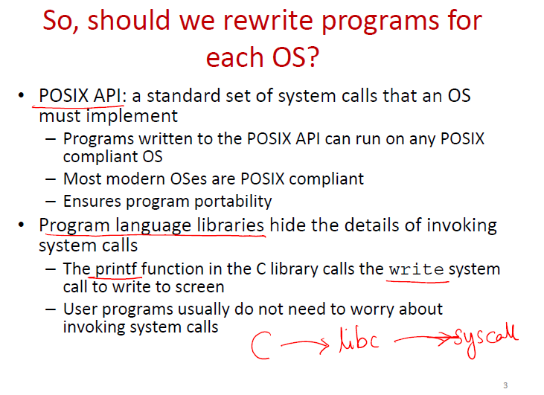

Slide 22
Lecture Outline
Process related system calls in Unix
CPU-bound vs I/O-bound Processes
Memory layout of a C program
Context Switch
CPU Scheduling

Slide 23
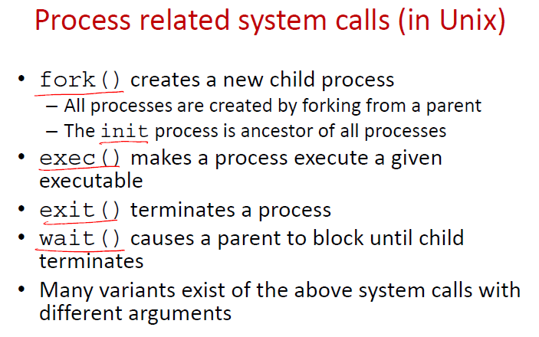

Slide 24
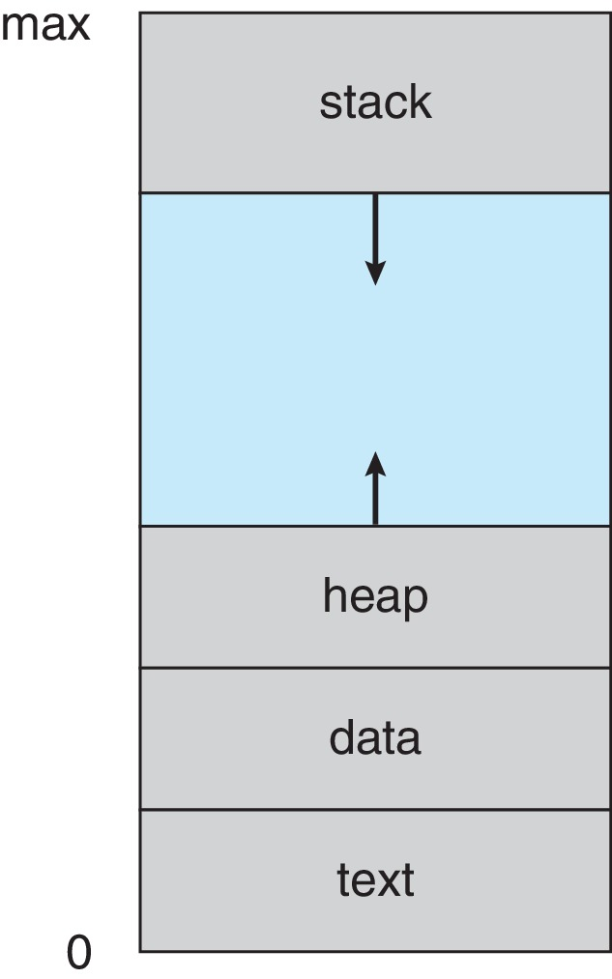
Process in Memory

Slide 25
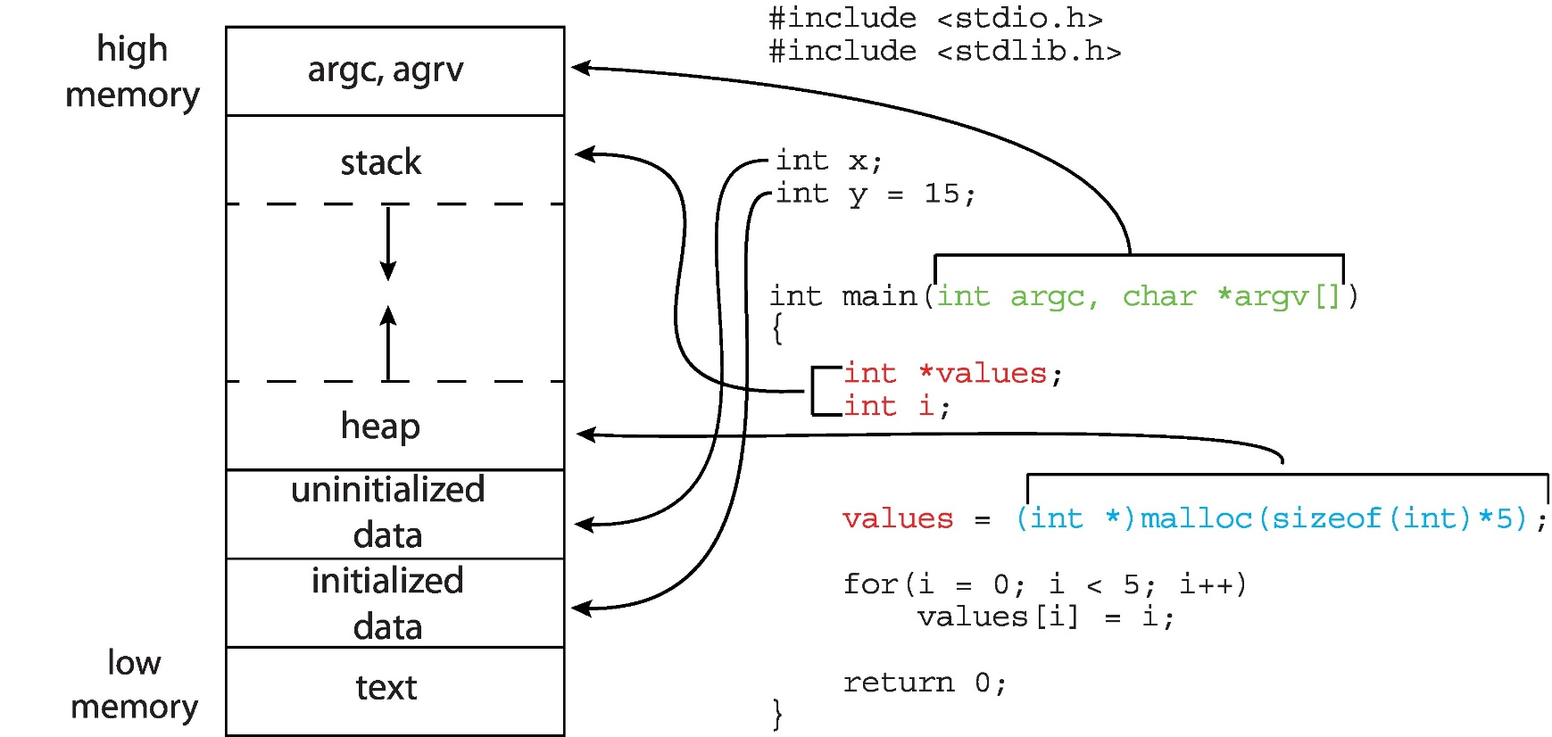
Memory Layout of a C Program

Slide 26
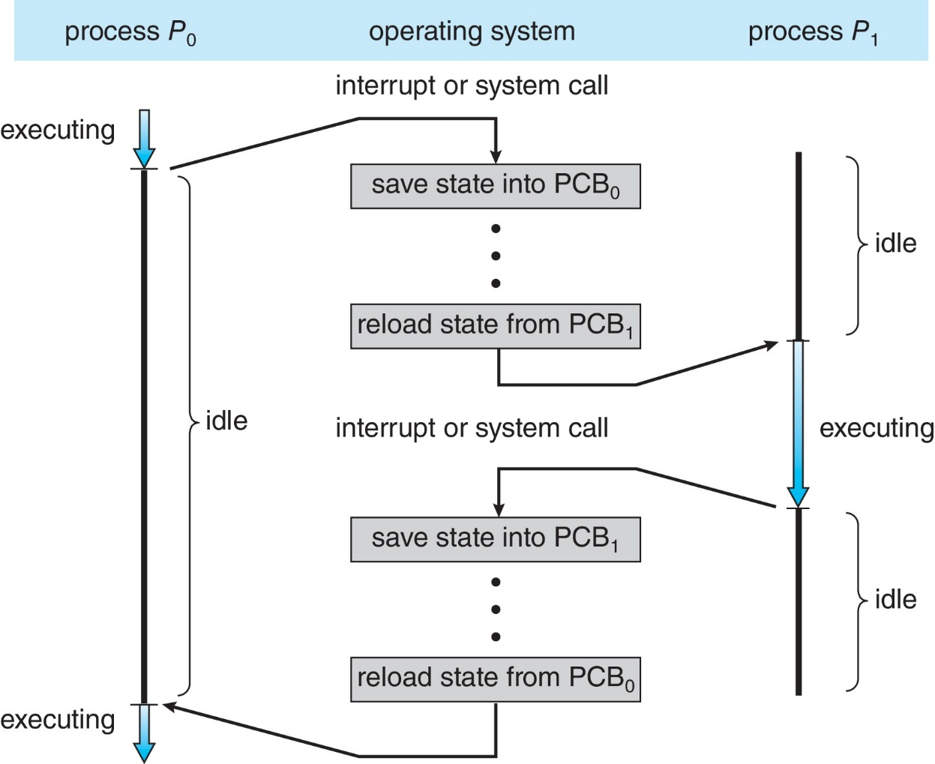
CPU Switch From Process to Process
A context switch occurs when the CPU switches from one process to another.

Slide 27
Context Switch
When CPU switches to another process, the system must save the state of the old process and load the saved state for the new process via a context switch
Context of a process represented in the PCB
Context-switch time is pure overhead; the system does no useful work while switching
The more complex the OS and the PCB ➔ the longer the context switch
Time dependent on hardware support
Some hardware provides multiple sets of registers per CPU ➔ multiple contexts loaded at once

Slide 28
Multitasking in Mobile Systems
Some mobile systems (e.g., early version of iOS) allow only one process to run, others suspended
Due to screen real estate, user interface limits iOS provides for a
Single foreground process- controlled via user interface
Multiple background processes– in memory, running, but not on the display, and with limits
Limits include single, short task, receiving notification of events, specific long-running tasks like audio playback
Android runs foreground and background, with fewer limits
Background process uses a service to perform tasks
Service can keep running even if background process is suspended
Service has no user interface, small memory use

Slide 29
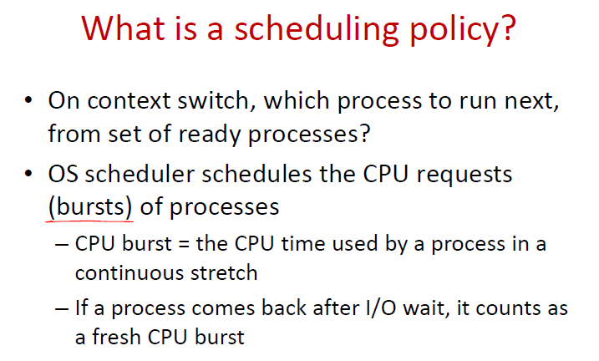

Slide 30
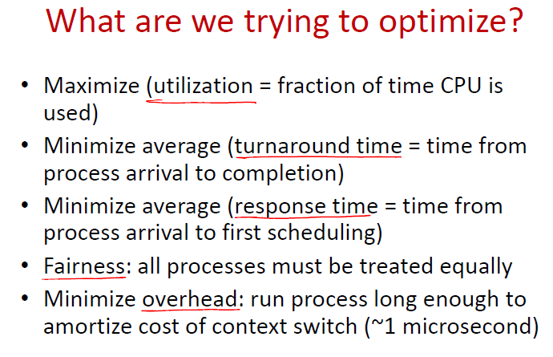

Slide 31
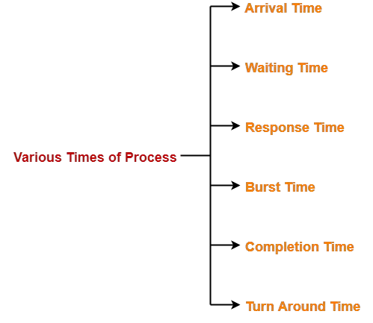
Various Times related to Processes

Slide 32
Various Times related to Processes
Turn-around Time:
The difference between “Completion time” and “Arrival time”.
In between arrival time and completion time, process will be either “waiting or executing”, assuming there is no I/O request.
Turn around time = CT - AT = Burst Time + Waiting Time
Waiting Time:
Waiting Time = Turn around Time – Burst Time
Response Time:
The time at which the process hits the CPU first time, it arrives.
Response Time = First Time – Arrival Time

Slide 33
CPU Scheduling
First Come First Serve (FCFS):
Advantages-
It is simple and easy to understand.
It can be easily implemented using queue data structure.
The process which arrives first in the ready queue is firstly assigned the CPU.
In case of a tie, process with smaller process id is executed first.
It is always non-preemptive in nature
Disadvantages-
It does not consider the priority or burst time of the processes.
It suffers from convoy effect

Slide 34
1
Process No | Arrival Time | Burst Time
P1 | 3 | 4
P2 | 5 | 3
P3 | 0 | 2
P4 | 5 | 1
P5 | 4 | 3
2
Process No | Arrival Time | Burst Time
P1 | 0 | 4
P2 | 1 | 3
P3 | 2 | 1
P4 | 3 | 2
P5 | 4 | 5

Slide 35
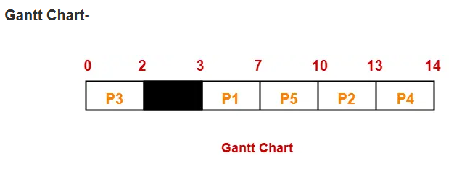
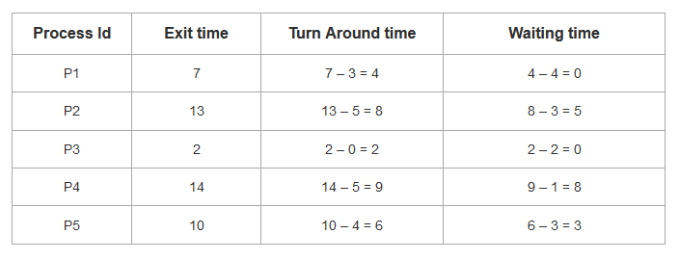
Solution to Problem 1
CT

Slide 36
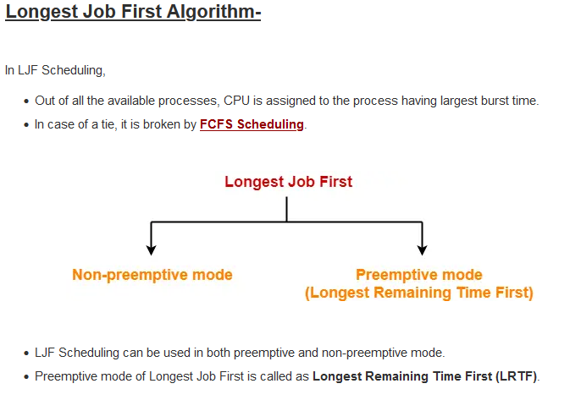

Slide 37
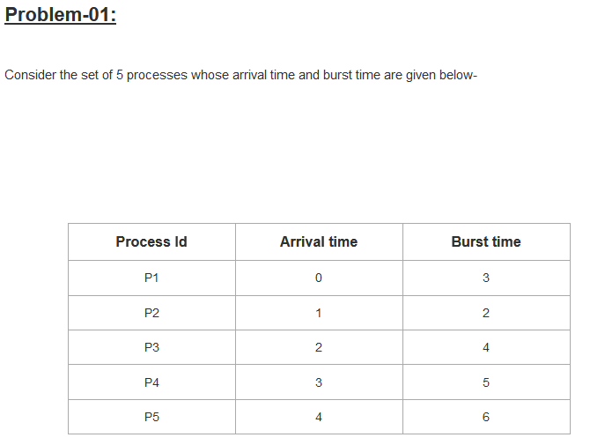

Slide 38
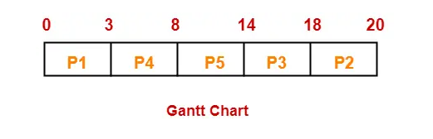
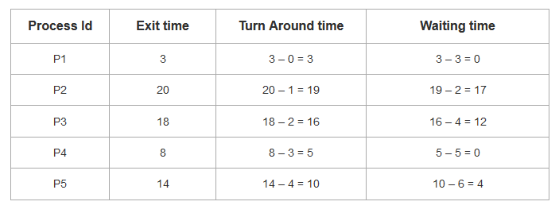
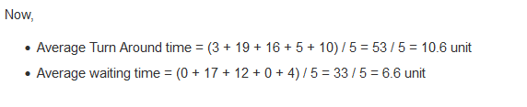

Slide 39
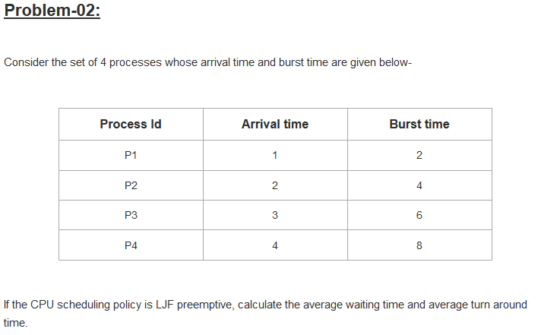

Slide 40
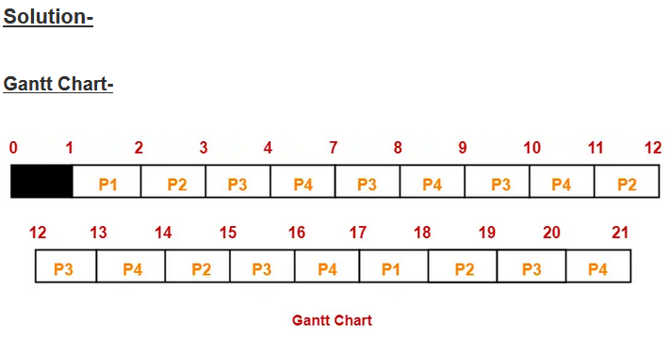
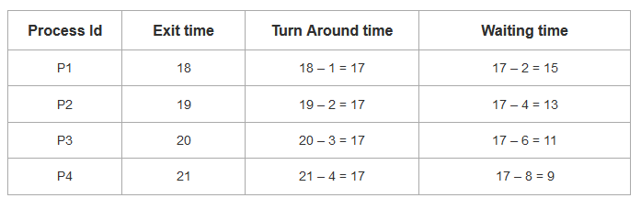
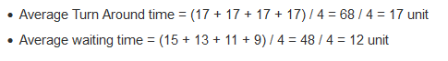

Slide 41
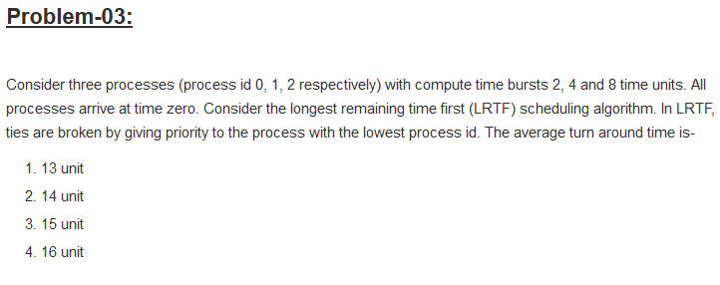

Slide 42
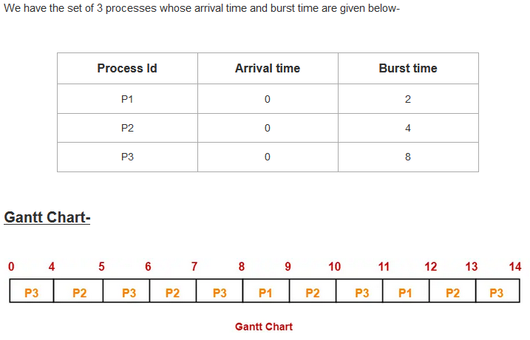
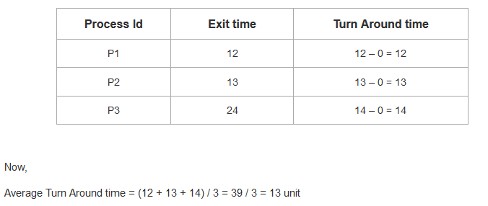

Slide 43
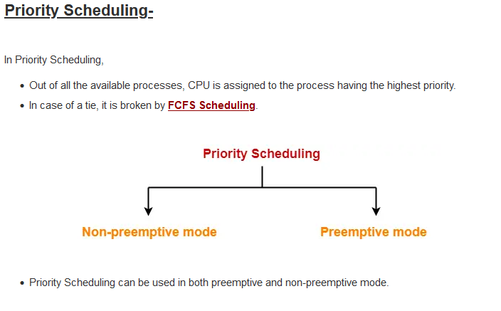

Slide 44
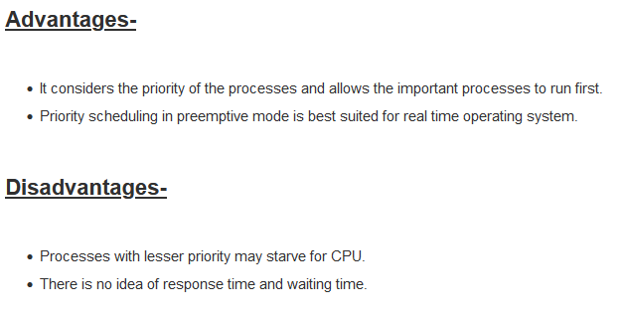
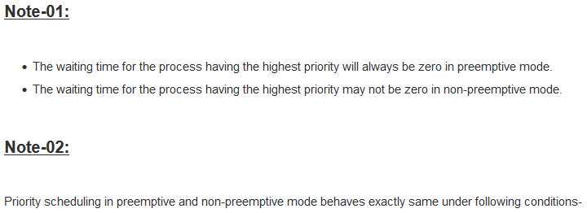
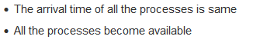

Slide 45
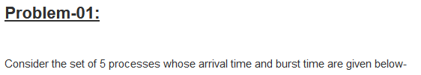
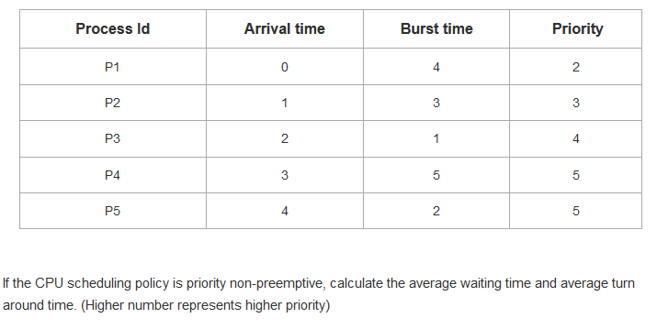

Slide 46
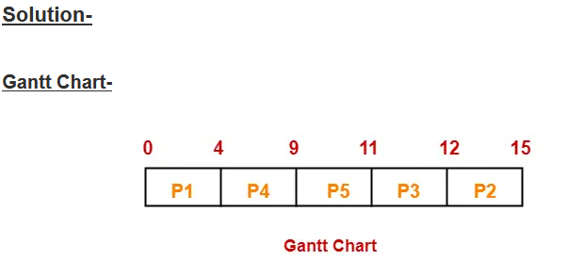
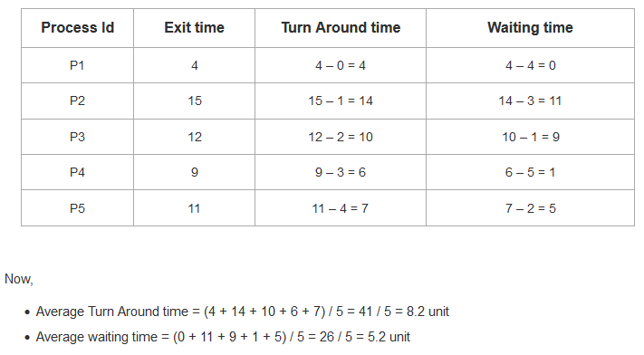

Slide 47
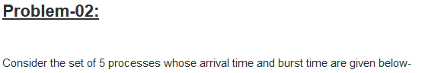
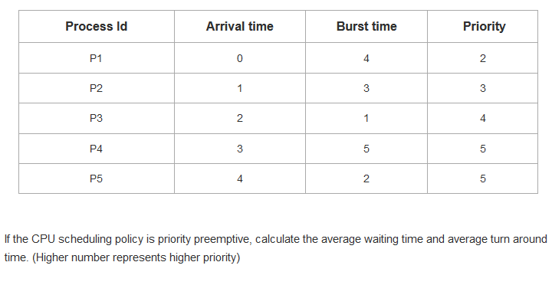

Slide 48
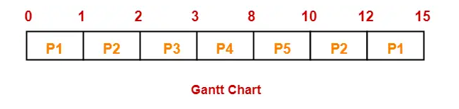
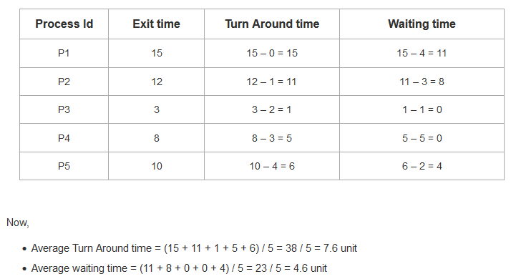

Slide 49
Multilevel Queue
Having one Queue and scheduling all the processes is difficult, in the sense that there are various processes in a computer.
Processes are permanently assigned to one queue, based on some property of the process, such as memory size, priority, type etc.
System processes
Interactive processes (Online Games) (Foreground processes)
Batch processes (generally Background processes
Student processes (Normal programs)

Slide 50
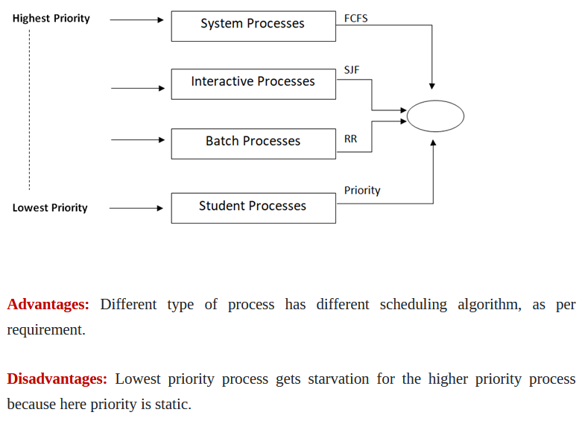
CPU

Slide 51
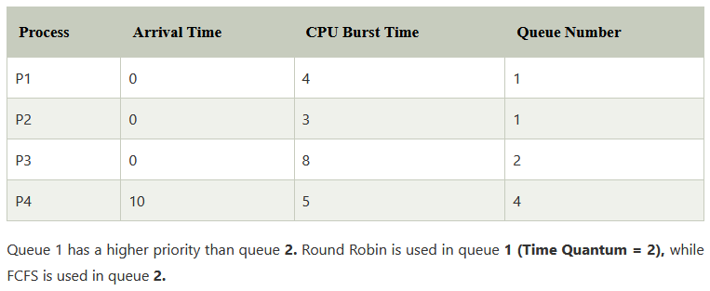

Slide 52
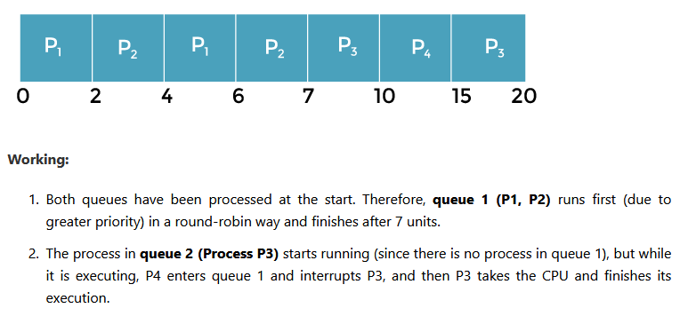

Slide 53
Multilevel Feedback Scheduling
This strategy prioritizes operations that require I/O and are interactive.
It enables a process to switch between queues.
If a process consumes too much processor time, it will be switched to the lowest priority queue.
A process waiting in a lower priority queue for too long may be shifted to a higher priority queue. This type of aging prevents starvation.

Slide 54
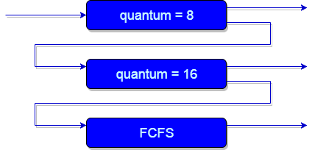
Multilevel Feedback Scheduling

Slide 55

Parameters for multilevel feedback scheduling

Slide 56

Guaranteed Scheduling

Slide 57

Guaranteed Scheduling

Slide 58

Guaranteed Scheduling

Slide 59



Slide 60


Slide 61
For example, if four users (A,B,C,D) are concurrently executing one process each, the scheduler will logically divide the available CPU cycles such that each user gets 25% of the whole (100% / 4 = 25%). If user B starts a second process, each user will still receive 25% of the total cycles, but each of user B's processes will now be attributed 12.5% of the total CPU cycles each, totaling user B's fair share of 25%. On the other hand, if a new user starts a process on the system, the scheduler will reapportion the available CPU cycles such that each user gets 20% of the whole (100% / 5 = 20%).
Another layer of abstraction allows us to partition users into groups, and apply the fair share algorithm to the groups as well. In this case, the available CPU cycles are divided first among the groups, then among the users within the groups, and then among the processes for that user. For example, if there are three groups (1,2,3) containing three, two, and four users respectively, the available CPU cycles will be distributed as follows:
100% / 3 groups = 33.3% per group Group 1: (33.3% / 3 users) = 11.1% per user Group 2: (33.3% / 2 users) = 16.7% per user Group 3: (33.3% / 4 users) = 8.3% per user.

Slide 62
Lottery Scheduling
Lottery scheduling is a process scheduling algorithm used in operating systems that assign processes a fixed number of "lottery tickets" based on their priority, determining their likelihood of execution.
The higher the priority of a process, the more tickets the lottery process scheduling algorithm receives.
The scheduler chooses a ticket at random from the pool of available tickets. For execution, this algorithm chooses the process that owns the winning ticket.
The lottery scheduling algorithm is probabilistic.

Slide 63


Slide 64


Slide 65


Slide 66


Slide 67


Slide 68


Slide 69


Slide 70
Lecture Outline
Operations on Processes
Creation
Termination
Zombie Process
Orphan Process
Threads

Slide 71
Operations on Processes
System must provide mechanisms for:
Process creation
Process termination

Slide 73
Process Creation
Parent process create children processes, which, in turn create other processes, forming a tree of processes
Generally, process identified and managed via a process identifier (pid)
Resource sharing options
Parent and children share all resources
Children share subset of parent’s resources
Parent and child share no resources
Execution options
Parent and children execute concurrently
Parent waits until children terminate

Slide 74

Process Creation (Cont.)
Address space
Child duplicate of parent
Child has a program loaded into it
UNIX examples
fork() system call creates new process
exec() system call used after a fork() to replace the process’ memory space with a new program
Parent process calls wait()waiting for the child to terminate

Slide 75

A Tree of Processes in Linux

Slide 76


Slide 77


Slide 78

C Program Forking Separate Process

Slide 79


Slide 80
Process Termination
Process executes last statement and then asks the operating system to delete it using the exit() system call.
Returns status data from child to parent (via wait())
Process’ resources are deallocated by operating system
Parent may terminate the execution of children processes using the abort() system call. Some reasons for doing so:
Child has exceeded allocated resources
Task assigned to child is no longer required
The parent is exiting, and the operating systems does not allow a child to continue if its parent terminates

Slide 81
Process Termination contd..
Some operating systems do not allow child to exists if its parent has terminated. If a process terminates, then all its children must also be terminated.
cascading termination. All children, grandchildren, etc., are terminated.
The termination is initiated by the operating system.
The parent process may wait for termination of a child process by using the wait()system call. The call returns status information and the pid of the terminated process
pid = wait(&status);
If no parent waiting (did not invoke wait()) process is a zombie
If parent terminated without invoking wait(), process is an orphan

Slide 82


Slide 83
Introduction to Threads
The process model discussed so far has implied that a process is a program that performs a single thread of execution.
For example, when a process is running a word-processor program, a single thread of instructions is being executed. This single thread of control allows the process to perform only one task at a time. Thus, the user cannot simultaneously type in characters and run the spell checker.
Most modern operating systems have extended the process concept to allow a process to have multiple threads of execution and thus to perform more than one task at a time. This feature is especially beneficial on multicore systems, where multiple threads can run in parallel.
A multithreaded word processor could, for example, assign one thread to manage user input while another thread runs the spell checker. On systems that support threads, the PCB is expanded to include information for each thread.

Slide 84

Threads
A thread is a basic unit of CPU utilization.
It comprises a thread ID, a program counter (PC), a register set, and a stack. It shares with other threads belonging to the same process its code section, data section, and other operating-system resources, such as open files and signals.
A thread is the smallest unit of execution within a process.
Threads are light weight processes.

Slide 85

Single and Multithreaded Processes

Slide 86
Benefits of Multithreading
Responsiveness – may allow continued execution if part of process is blocked, especially important for user interfaces
Resource Sharing – threads share resources of process, easier than shared memory or message passing.
Economy – cheaper than process creation, thread switching lower overhead than context switching.
Scalability – process can take advantage of multicore architectures.

Slide 87
Challenges in programming for multicore systems:
Multicore or multiprocessor challenges include:
Identifying tasks
Balance
Data splitting
Data dependency
Testing and debugging

Slide 88


Multicore Programming
Concurrency vs. Parallelism
Concurrent execution on single-core system:
Parallelism on a multi-core system:

Slide 89
Multicore Programming
Parallelism implies a system can perform more than one task simultaneously.
Concurrency supports more than one task making progress.
Single processor / core, scheduler providing concurrency
Types of parallelism
Data parallelism – distributes subsets of the same data across multiple cores, same operation on each
Task parallelism – distributing threads across cores, each thread performing unique operation

Slide 90

Data and Task Parallelism

Slide 91

Types of Threads User and Kernel Threads
UT: Supported above the kernel and are managed without kernel support.
KT: Supported and managed directly by the OS.
Ultimately, there must exist a relationship between user threads and kernel threads.
Multithreading models

Slide 92
Multithreading Models
Many-to-One
One-to-One
Many-to-Many

Slide 93

Many-to-One
Many user-level threads mapped to single kernel thread
Thread mgt. is done by the thread library in the user space, so it is efficient.
One thread blocking causes all to block
Multiple threads may not run in parallel on multicore system because only one may be in kernel at a time
Few systems currently use this model
Examples:
Solaris Green Threads

Slide 94

One-to-One
maps each user-level thread to kernel thread
Creating a user-level thread creates a kernel thread
More concurrency than many-to-one
Also allows multiple threads to run in parallel on multiprocessors.
Creating a user thread requires creating a kernel thread.
Number of threads per process sometimes restricted due to overhead of kernel threads.

Slide 95

Many-to-Many Model (Hybrid)
Allows many user level threads to be mapped to many kernel threads.
Multiplexes many user threads to smaller or equal number of kernel threads.
Allows the operating system to create a sufficient number of kernel threads.
Also, when a threads performs a blocking system call, the kernel can schedule another thread for execution.

Slide 96

Two-level Model
Similar to M:M, except that it allows a user thread to be bound to kernel thread

Slide 97
Hyperthreading or SMT
Simultaneous Multithreading (SMT).
Each physical CPU core appears as two (or more) logical cores to the OS.
The hardware can execute instructions from multiple threads in parallel if resources (like execution units) are free.
Example: A quad-core CPU with hyper-threading shows up as 8 logical processors.
NOTE:
Multithreading models = OS/software concept (how threads map to kernel scheduling units).
Hyper-Threading = CPU/hardware concept (how a physical core can execute multiple instruction streams at once).

Slide 98
Thread Libraries
Thread library provides programmer with API for creating and managing threads
Two primary ways of implementing
Library entirely in user space
Kernel-level library supported by the OS

Slide 99
Threading Issues
Semantics of fork() and exec() system calls
Signal handling
Synchronous and asynchronous
Thread cancellation of target thread
Asynchronous or deferred

Slide 100
Semantics of fork() and exec()
Does fork()duplicate only the calling thread or all threads?
Some UNIXes have two versions of fork
exec() usually works as normal – replace the running process including all threads

Slide 101
Thread Cancellation
Thread cancellation is the task of terminating a thread before it has completed.
For example,
Ex.1. If multiple threads are concurrently searching through a database and one thread returns the result, the remaining threads might be canceled.
Ex. 2. When a user presses a button on a web browser that stops a web page from loading any further, all threads loading the page are canceled.
Thread to be canceled is referred as target thread.

Slide 102
Thread Cancellation
Cancellation of a target thread may occur in two different scenarios:
Asynchronous cancellation: One thread immediately terminates the target thread.
Deferred cancellation: The target thread periodically checks whether it should terminate, allowing it an opportunity to terminate itself in an orderly fashion.
Where the difficulty lies in thread cancellation?
In situations where:
Resources have been allocated to a canceled thread.
A thread is canceled while in the midst of updating data it is sharing with other threads.
Often, the OS will reclaim system resources from a canceled thread but will not reclaim all resources.
Therefore, canceling a thread asynchronously may not free a necessary system-wide resource.

Slide 103
With deferred cancellation:
One thread indicates that a target thread is to be canceled.
But cancellation occurs only after the target thread has checked a flag to determine if it
should be canceled or not.
This allows a thread to check whether it should be canceled at a point when it can be canceled safely.

Slide 104
Process | Thread
A program in execution | A thread is the smallest unit of execution within a process.

Slide 105
Contention Scope
The word contention here refers to the competition or fight among the User level threads to access the kernel resources. Thus, this control defines the extent to which contention takes place. It is defined by the application developer using the thread library.
Depending upon the extent of contention it is classified as:
PCS and SCS

Slide 106
Process Contention Scope (PCS) : The contention takes place among threads within a same process. The thread library schedules the high-prioritized PCS thread to access the resources via available LWPs (priority as specified by the application developer during thread creation).
System Contention Scope (SCS) : The contention takes place among all threads in the system. In this case, every SCS thread is associated to each LWP by the thread library and are scheduled by the system scheduler to access the kernel resources.

Slide 107
What are Pthreads?
Pthreads = POSIX Threads
POSIX = Portable Operating System Interface (a standard defined by IEEE).
It’s a standard API (Application Programming Interface) for creating and managing threads in C and C++.
Implemented in many OSes: Linux, UNIX, macOS, etc.
Pthreads as a library of functions that lets you:
Create threads,
Synchronize them,
Share data safely,
Coordinate execution.

Slide 108
Pthreads API (Core Functions)
Creating a thread
#include <pthread.h>
pthread_t tid; // thread identifier
pthread_create(&tid, NULL, myFunction, arg);
2. Exiting a thread
pthread_exit(NULL);
3. Waiting for a thread to finish
pthread_join(tid, NULL);
4. Mutexes (Mutual Exclusion Locks)
Used to prevent race conditions when threads access shared data.
pthread_mutex_t lock;
pthread_mutex_init(&lock, NULL);

Slide 109
Q: A thread switch takes 2 µs, while a process context switch takes 5 µs. If 1000 switches occur in a program run: Find the total overhead for thread-based execution. Find the total overhead for process-based execution. How much time is saved by using threads?
Overhead=Switch time×Number of switches

Slide 111
Pthreads
May be provided either as user-level or kernel-level
A POSIX standard (IEEE 1003.1c) API for thread creation and synchronization
Specification, not implementation
API specifies behavior of the thread library, implementation is up to development of the library
Common in UNIX operating systems (Linux & Mac OS X)

Slide 112

Pthreads Example

Slide 113

Pthreads Example (Cont.)

Slide 114
Pthreads Code for Joining 10 Threads

Slide 115
Signal Handling
Signals are used in UNIX systems to notify a process that a particular event has occurred.
A signal handler is used to process signals
Signal is generated by particular event
Signal is delivered to a process
Signal is handled by one of two signal handlers:
default
user-defined
Every signal has default handler that kernel runs when handling signal
User-defined signal handler can override default
For single-threaded, signal delivered to process

Slide 116
Signal Handling (Cont.)
Where should a signal be delivered for multi-threaded?
Deliver the signal to the thread to which the signal applies
Deliver the signal to every thread in the process
Deliver the signal to certain threads in the process
Assign a specific thread to receive all signals for the process

Slide 117


Slide 118


